Slide 1

Data Science Framework Report
Marcelo Jimenez

Slide 2
Goals
To understand and predict how much credit to allow each customer. Building an accurate model to predict the default status of future and current customers as well as a model to estimate the optimal credit value for each customer.

Slide 3
Process framework – zumel and mount
Define the goal – predict the default status of customers with at least 75% accuracy and assign appropriate credit balances for each customer.
Build the model –will start with RandomForest modeling as it is one of the most accurate models for prediction in supervised learning.
Evaluate and critique the model – measure and attempt to improve accuracy
Presentation of Results – Use data visualization methods to convey the accuracy and meaning of the model to stakeholders.
Deploy and maintain – Address how to deploy and maintain the model, under what circumstances should it be revised or upgraded.

Slide 4
Data
All data is taken from credit one database and extracted as a .csv file using python
The data - contains information about the education, age, marriage status, billing, payment, credit balance, and gender of customers.
Issues – data contains a repeated header around the 200th row which will be removed along with the repeated values for the machine learning algorithms.

Slide 5
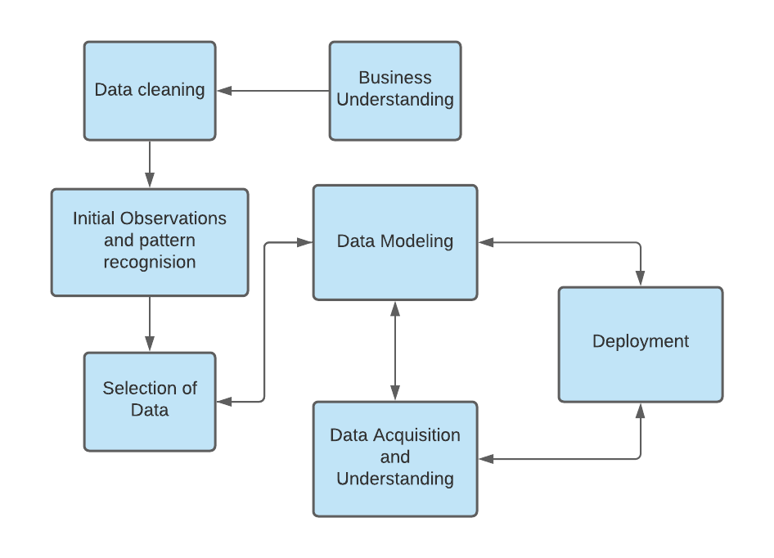
Flow chart
Machine learning models can always be optimized to improve, storage, speed, or accuracy and so certain parts of the process must be looped to account for improvement.

Slide 6
Pitfalls
To avoid usage of unnecessary storage space, the cleaning of the data must be through to ensure no redundant or inconsequential data is used.
Furthermore, upon initial inspection, it could be beneficial to create various separate and tailored models for various credit balance ranges.

Slide 7
Initial insights
The data includes 25 features and 30,201 labels, 236 of which are repeated, the data includes close to 18,000 males and 12,000 females.

